Slide 1

IA2 – PAPER IMPLEMENTATION

Slide 2
Action Plan
Utilization of XAMPP Server for the creation of a hospital portal, where,
Doctors can access their patient records, schedules.
Patients can access their records and prescriptions

Slide 3

Main Page

Slide 4
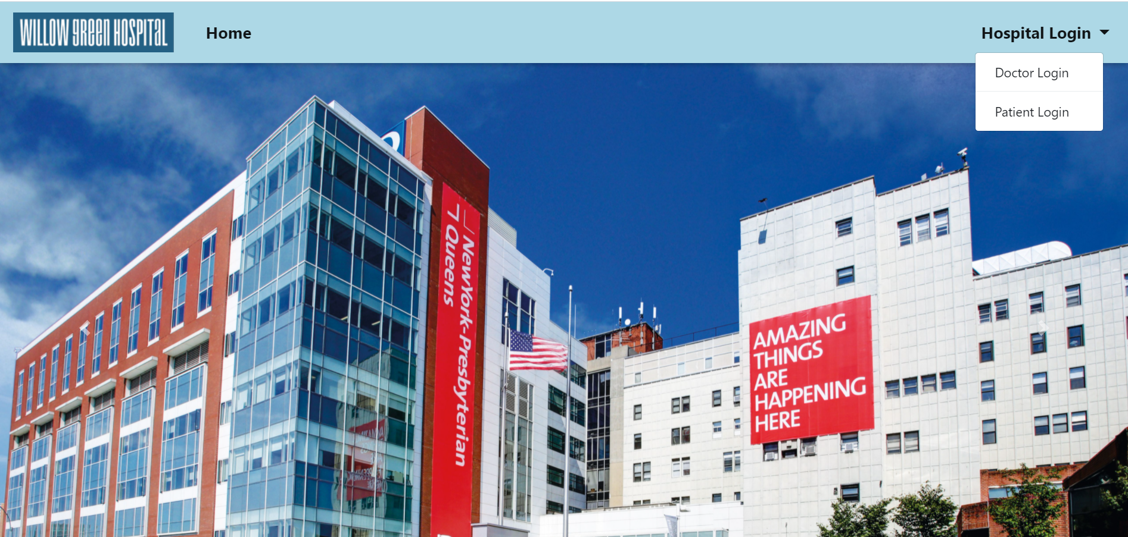
Dropdown Menu on Home Page

Slide 5

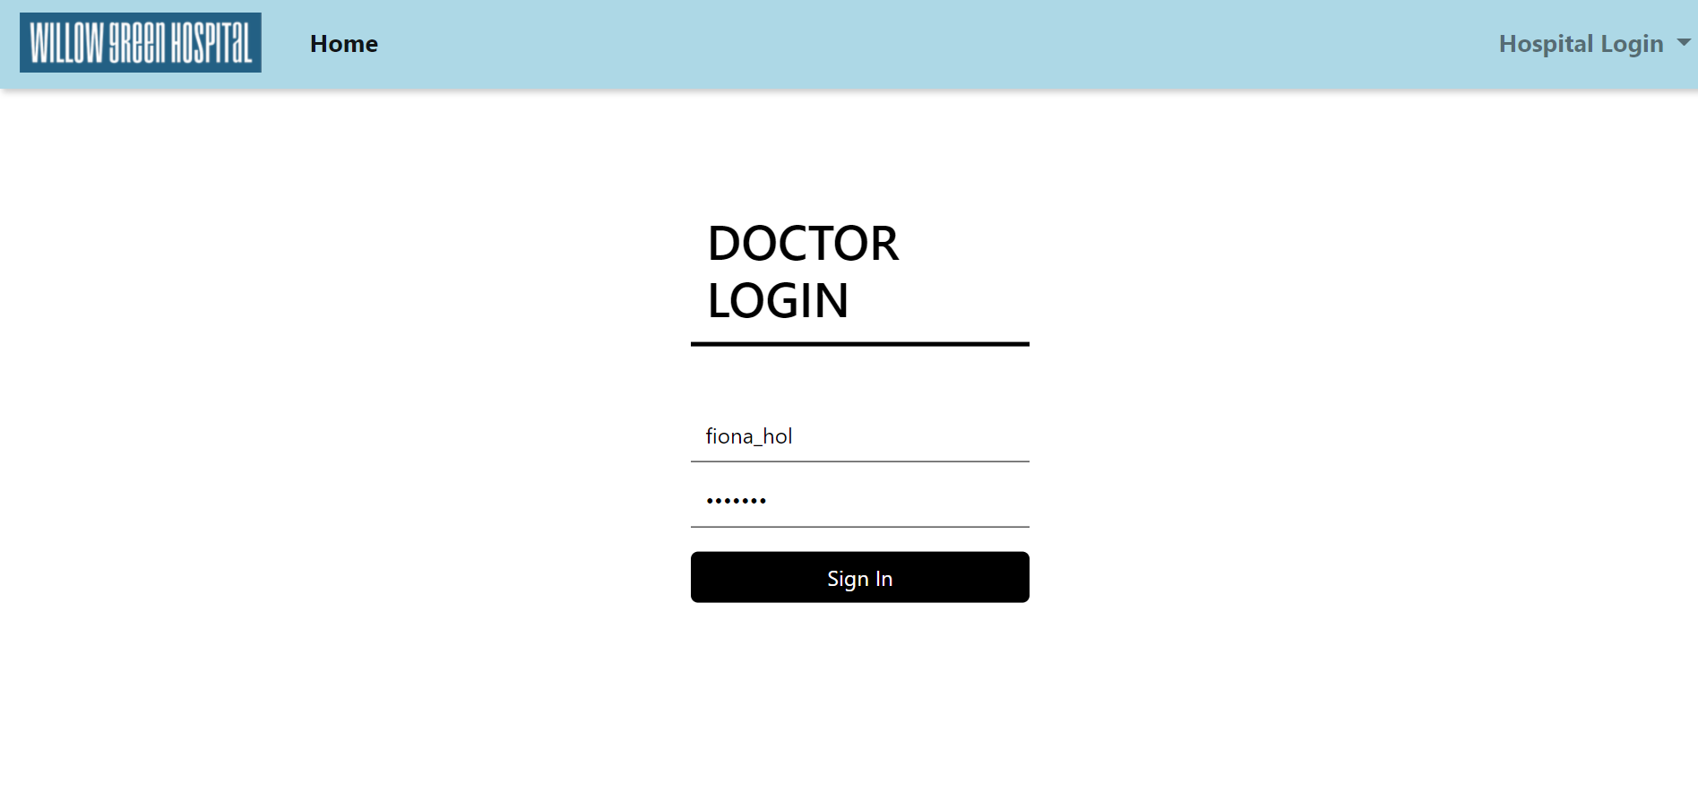
Doctor Login Page – this page requires a valid username/password combination which should already be stored in the doctor table in the hospital database

Slide 6
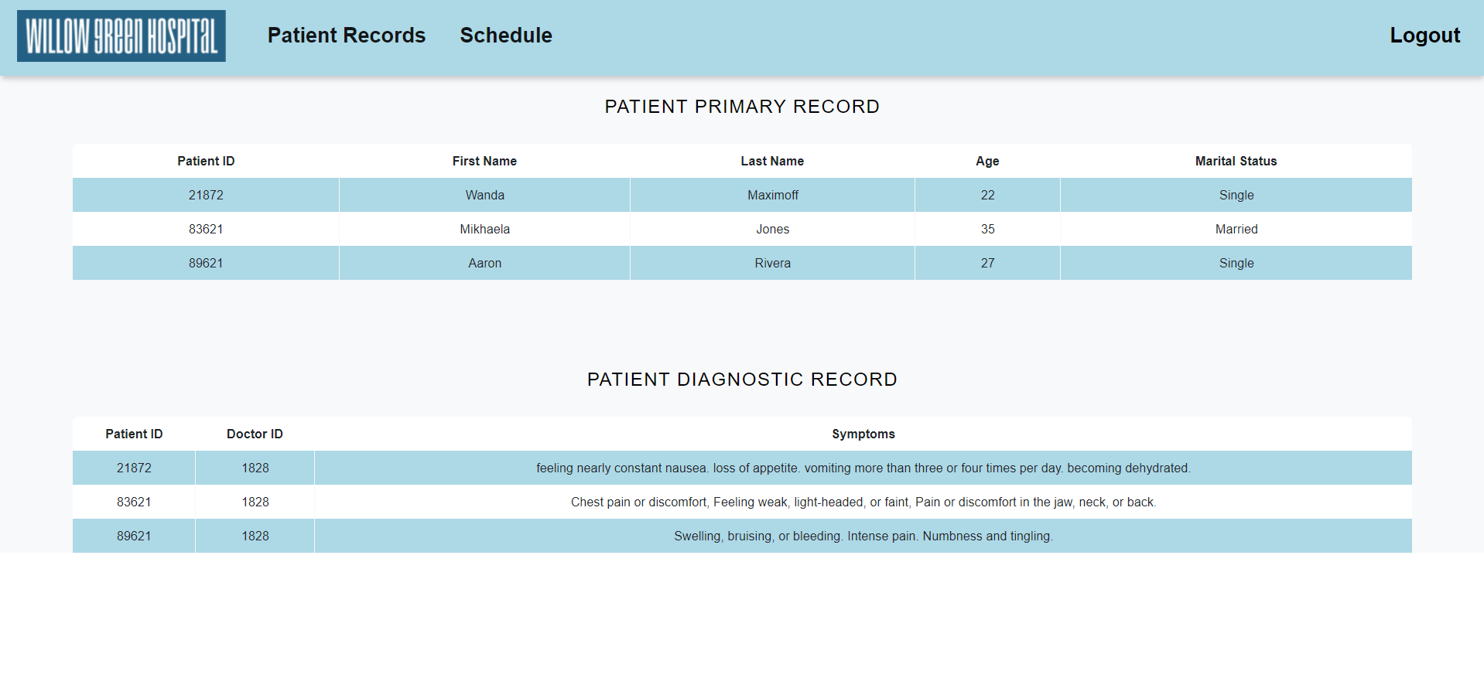
After signing in, the doctor is able to view the records of all his patients

Slide 7
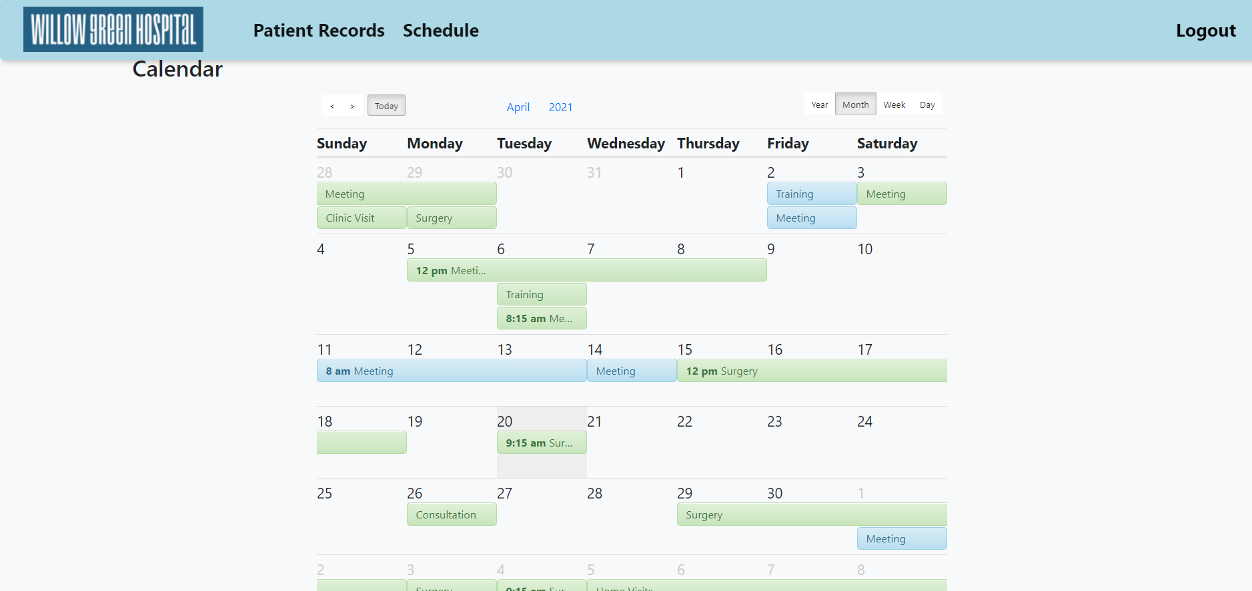

Slide 8
Patient Registration / Login
When a patient is admitted into the hospital, they are given a patient ID.
Then, later if the patient wants to access his/her record or prescription, they have to register using that patient id with their choice of username and password
During this registration process the program checks whether the patient ID previously exists in the patient records table in the database
If it does, registration is successful
Else, an error pops up describing that they don’t have a valid patient ID yet

Slide 9
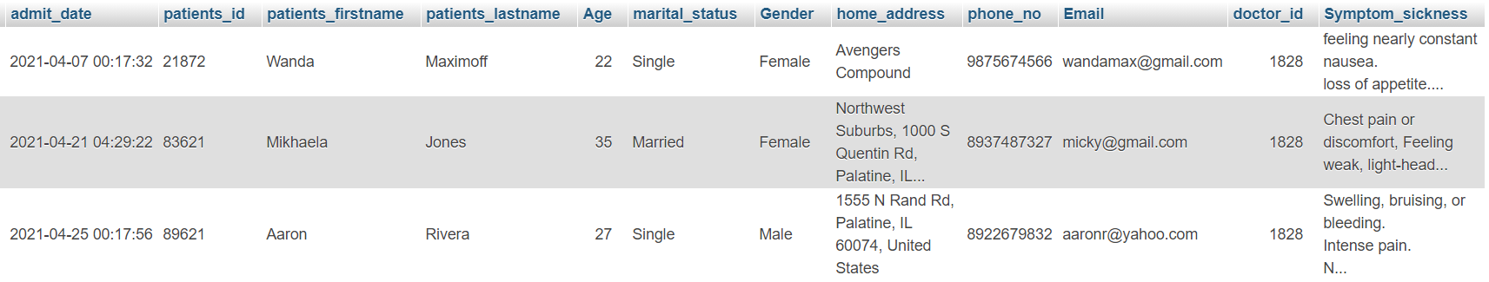
Patient Records Table in Database

Slide 10
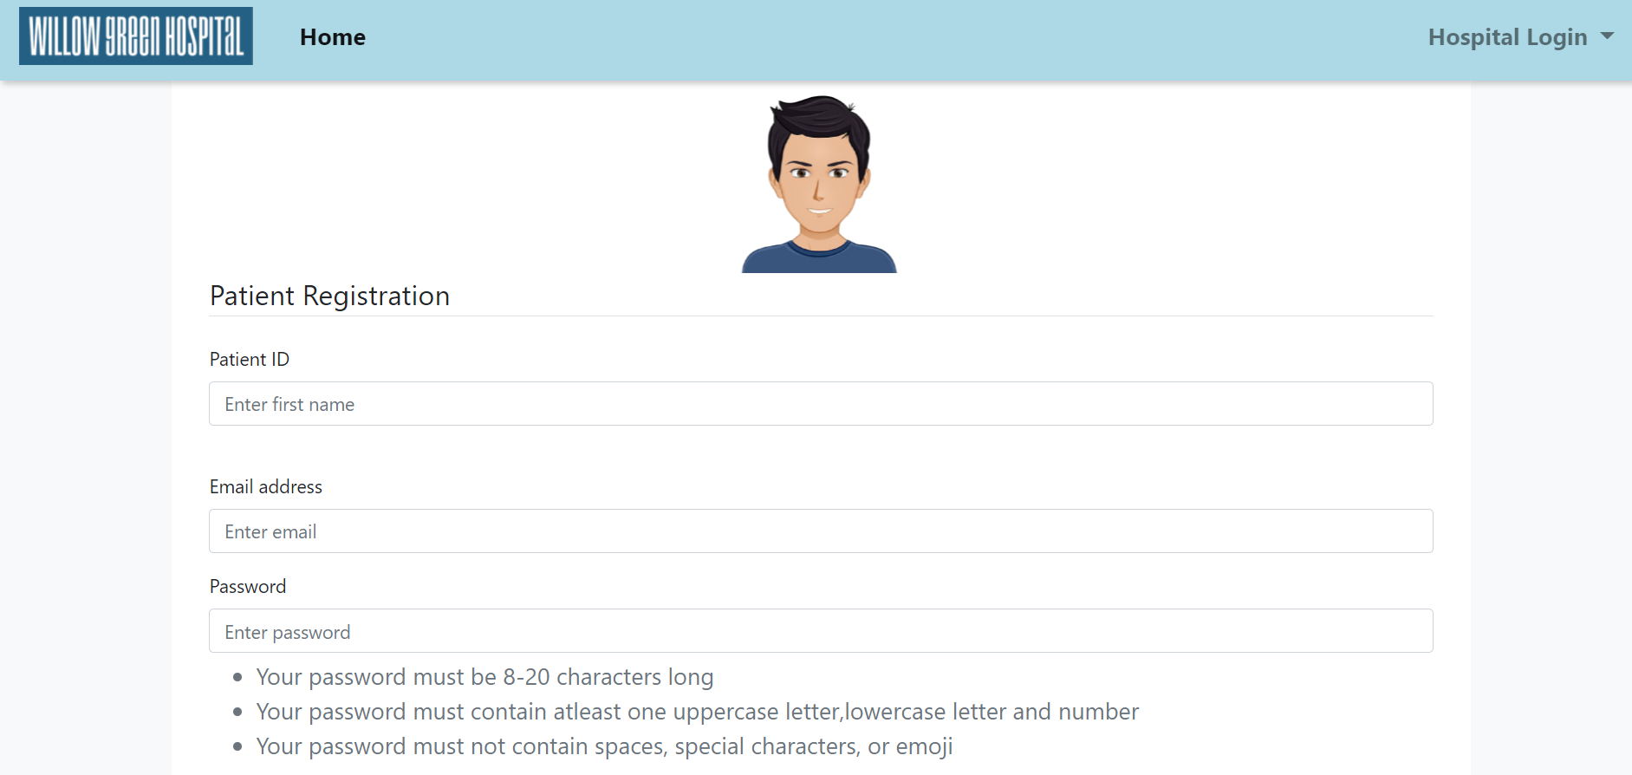
Patient Registration

Slide 11
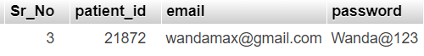
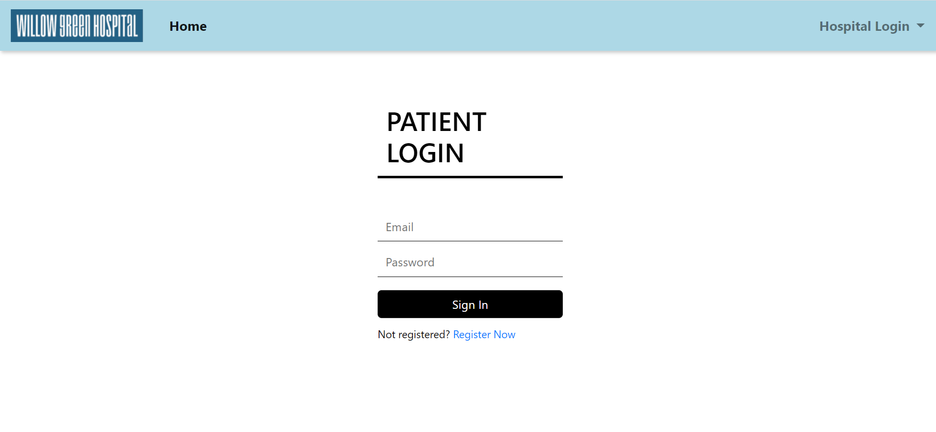
Patient Login

Slide 12
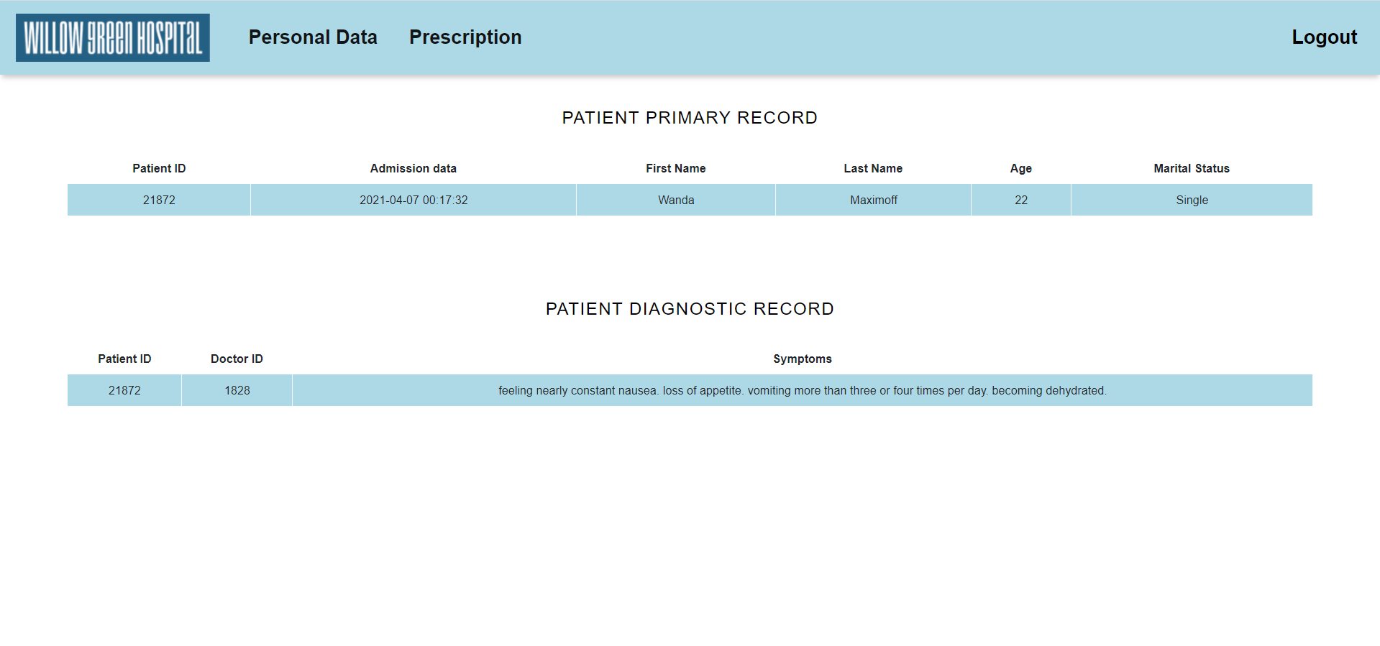
After Successful Login

Slide 13
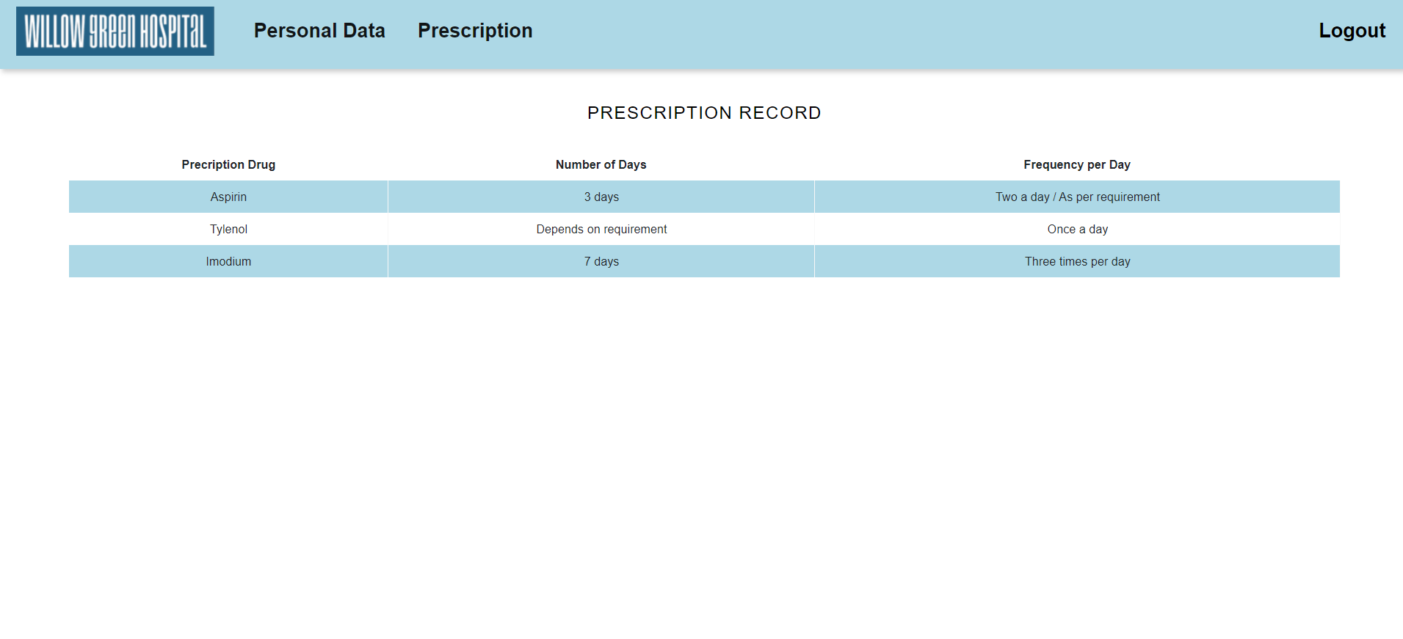

Slide 14
Link to Website and Database
http://localhost/Hospital-Management/index.php
http://localhost/phpmyadmin/db_structure.php?db=hospital

